Slide 1
Sudoku Solution Validator
Project Candidates:
Akhil Cherukuri [014525420]
Dishant Shah [014615614]

Slide 2
What is Sudoku?
For the unfamiliar, sudoku is a puzzle in which you must fill in a 9x9 grid with the numbers 1–9, in such a way that the following rules are followed:
Each row must contain every number from 1 to 9 exactly once.
Each column, similarly, needs one of every number from 1 to 9.
Each 3x3 ‘region’ needs to follow the same 1–9 pattern.

Slide 3
Example of a Sudoku

Slide 4
What are POSIX Threads
In a Unix/Linux operating system, the C/C++ languages provide the POSIX thread(pthread) standard API(Application program Interface) for all thread related functions. It allows us to create multiple threads for concurrent process flow.

Slide 5
Benefits of Pthreads
Improve program performance
Reduce system overhead
Improve communication efficiency
Increase execution alternatives
Exploit potential parallelism

Slide 6
Objective of Sudoku Solution Validator
The objective of this project is to design a multithreaded application to determine whether the solution to a Sudoku puzzle is valid.
To achieve this, we plan to create eleven threads in total where in two threads would check each column and each row contains the digits 1 through 9 respectively and nine other threads would check that each of the 3x3 sub-grids contains the digits 1 through 9.

Slide 7
Our approach
Brute Force:
-> Having only a single thread for checking rows, columns, and 3x3 grids
Functions:
bool checkr(); //checks rows if count is 9 then the row contains all from 1-9 and return true or return false
bool checkc(); //checks columns if count is 9 then the column contains all from 1-9 and return true or return false
bool checkcol(); //checks each 3 by 3 grid and if the grid contains all from 1-9 and returns true or false.

Slide 8
Our approach
2) Multi-threading:
-> One thread for checking rows
-> One thread for checking columns
-> Nine threads for checking each 3x3 grid
-> Total: 11 threads

Slide 9
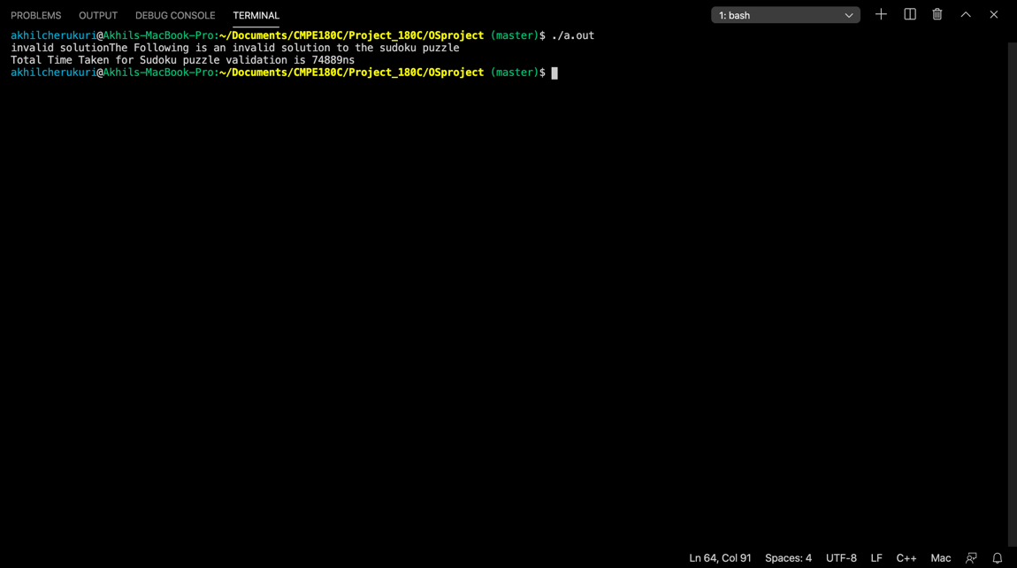
Results
Test Case 1:
Invalid Sudoku solution [Single thread]
{2, 3, 8, 3, 9, 5, 7, 1, 6},
{5, 7, 1, 6, 2, 8, 3, 4, 9},
{9, 3, 6, 7, 4, 1, 5, 8, 2},
{6, 8, 2, 5, 3, 9, 1, 7, 4},
{3, 5, 9, 1, 7, 4, 6, 2, 8},
{7, 1, 4, 8, 6, 2, 9, 5, 3},
{8, 6, 3, 4, 1, 7, 2, 9, 5},
{1, 9, 5, 2, 8, 6, 4, 3, 7},
{4, 2, 7, 9, 5, 3, 8, 6, 1}
Result:
Invalid solution.
The Following is an invalid solution to the sudoku puzzle
Total Time Taken for Sudoku puzzle validation is 74889ns

Slide 10
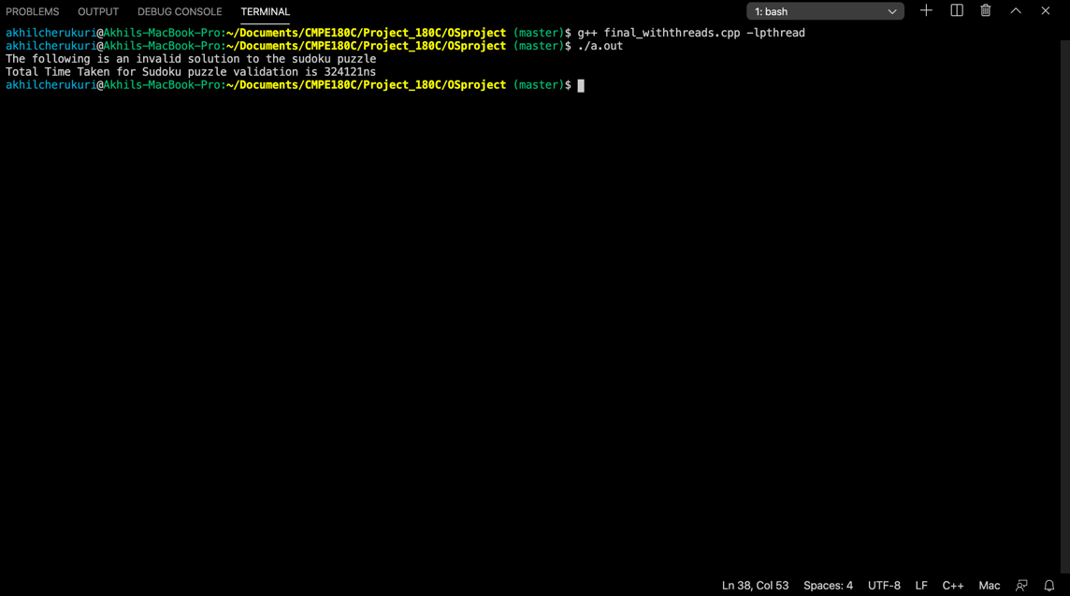
Results
Test Case 2:
Invalid Sudoku solution [11 threads]
{0, 4, 8, 3, 9, 5, 7, 1, 6},
{5, 7, 1, 6, 2, 8, 3, 4, 9},
{9, 3, 6, 7, 4, 1, 5, 8, 2},
{6, 8, 2, 5, 3, 9, 1, 7, 4},
{3, 5, 9, 1, 7, 4, 6, 2, 8},
{7, 1, 4, 8, 6, 2, 9, 5, 3},
{8, 6, 3, 4, 1, 7, 2, 9, 5},
{1, 9, 5, 2, 8, 6, 4, 3, 7},
{4, 2, 7, 9, 5, 3, 8, 6, 1}
Result:
Invalid solution.
The Following is an invalid solution to the sudoku puzzle
Total Time Taken for Sudoku puzzle validation is 324121ns

Slide 11
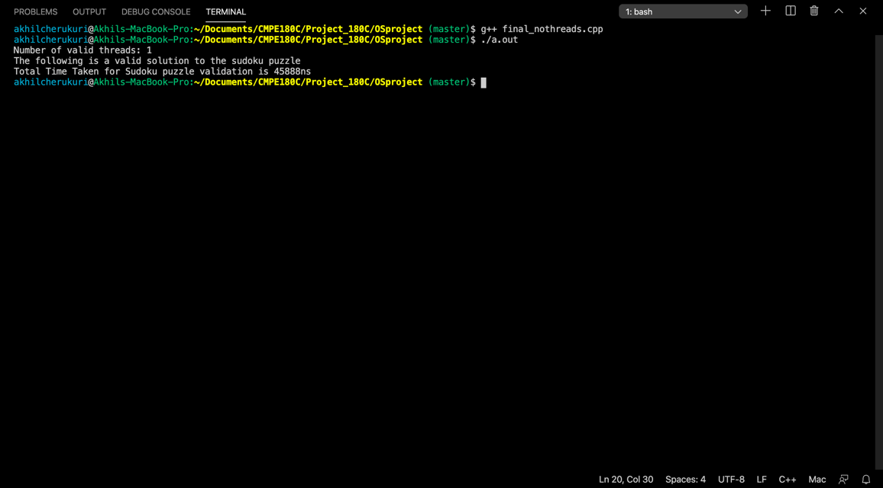
Results
Test Case 3:
Valid Sudoku Solution [Single thread]
{2, 3, 8, 3, 9, 5, 7, 1, 6},
{5, 7, 1, 6, 2, 8, 3, 4, 9},
{9, 3, 6, 7, 4, 1, 5, 8, 2},
{6, 8, 2, 5, 3, 9, 1, 7, 4},
{3, 5, 9, 1, 7, 4, 6, 2, 8},
{7, 1, 4, 8, 6, 2, 9, 5, 3},
{8, 6, 3, 4, 1, 7, 2, 9, 5},
{1, 9, 5, 2, 8, 6, 4, 3, 7},
{4, 2, 7, 9, 5, 3, 8, 6, 1}
Result:
Number of valid threads: 1
The following is a valid solution to the sudoku puzzle
Total Time Taken for Sudoku puzzle validation is 45888ns

Slide 12
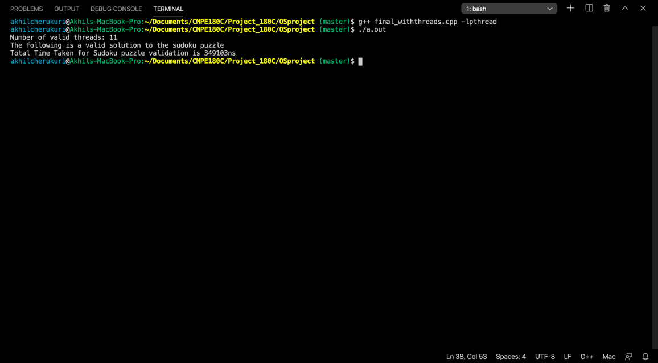
Results
Test Case 4:
Valid Sudoku Solution [11 threads]
{2, 4, 8, 3, 9, 5, 7, 1, 6},
{5, 7, 1, 6, 2, 8, 3, 4, 9},
{9, 3, 6, 7, 4, 1, 5, 8, 2},
{6, 8, 2, 5, 3, 9, 1, 7, 4},
{3, 5, 9, 1, 7, 4, 6, 2, 8},
{7, 1, 4, 8, 6, 2, 9, 5, 3},
{8, 6, 3, 4, 1, 7, 2, 9, 5},
{1, 9, 5, 2, 8, 6, 4, 3, 7},
{4, 2, 7, 9, 5, 3, 8, 6, 1}
Result:
Number of valid threads: 11
The following is a valid solution to the sudoku puzzle
Total Time Taken for Sudoku puzzle validation is 349103ns

Slide 13
Performance Analysis
Comparison between the runtime of valid and invalid solution in single multithreaded programs.

Slide 14
Conclusion
During our testing, we have observed that the multithread version was taking much more time to execute than the single thread version.
For small simple programs such a Sudoku (9 by 9 Model), single thread execution is much faster than multithread. Multithreading requires thread creation and handling overhead which increases the time and the resources required.
Creating a thread is a relatively expensive OS operation
Context switching (where the CPU stops working on one thread and starts working on another) is again a relatively expensive operation
Multithreading will definitely have advantages and performance improvement over single thread for complex code structures.

Slide 15

THANK YOU

